Slide 1
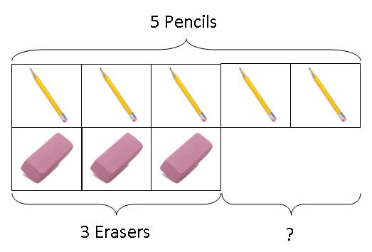
Subtraction: Comparison Model
Slides from the NCETM – PD Lead Support Programme 2013. Crown Copyright.
Peter has 5 pencils and 3 erasers. How
many more pencils than erasers does he
have?

Slide 2
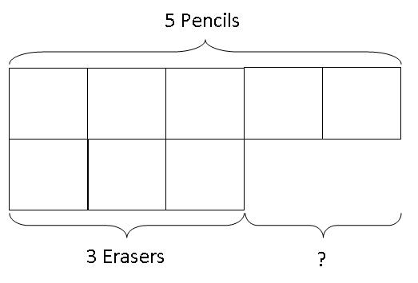
Moving to the abstract
Peter has 5 pencils and 3 erasers. How many more pencils than erasers does he have?
Notes:
Suggest that children are encouraged to visualise the objects in the spaces

Slide 3
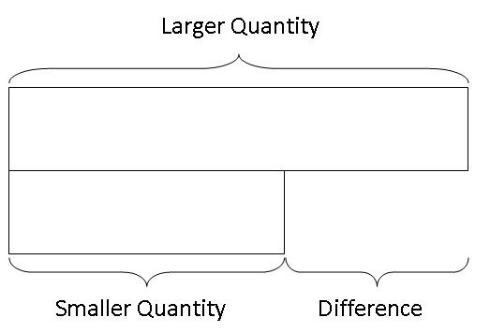
Generalisation
Notes:
Generalising the structure of the mathematics to any context

