Slide 1
Calculation Policy Division – Years 1-3

Slide 2
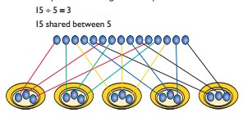
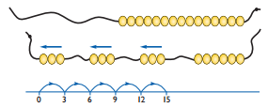
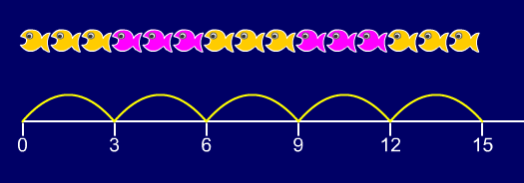
Year 1 | Year 2 | Year 3
Children must have secure counting skills- being able to confidently count in 2s, 5s and 10s. Children should be given opportunities to reason about what they notice in number patterns. Group AND share small quantities- understanding the difference between the two concepts. Sharing Develops importance of one-to-one correspondence. Children should be taught to share using concrete apparatus. Grouping Children should apply their counting skills to develop some understanding of grouping. Use of arrays as a pictorial representation for division. 15 ÷ 3 = 5 There are 5 groups of 3. 15 ÷ 5 = 3 There are 3 groups of 5. Children should be able to find ½ and ¼ and simple fractions of objects, numbers and quantities. | ÷ = signs and missing numbers 6 ÷ 2 = = 6 ÷ 2 6 ÷ = 3 3 = 6 ÷ ÷ 2 = 3 3 = ÷ 2 ÷ ∇ = 3 3 = ÷ ∇ Know and understand sharing and grouping- introducing children to the ÷ sign. Children should continue to use grouping and sharing for division using practical apparatus, arrays and pictorial representations. Grouping using a numberline Group from zero in jumps of the divisor to find our ‘how many groups of 3 are there in 15?’. 15 ÷ 3 = 5 Continue work on arrays. Support children to understand how multiplication and division are inverse. Look at an array – what do you see? | ÷ = signs and missing numbers Continue using a range of equations as in year 2 but with appropriate numbers. Grouping How many 6’s are in 30? 30 ÷ 6 can be modelled as: Becoming more efficient using a numberline Children need to be able to partition the dividend in different ways. 48 ÷ 4 = 12 +40 + 8 10 groups 2 groups Remainders 49 ÷ 4 = 12 r1 +40 + 8 + 1 10 groups 2 groups Sharing – 49 shared between 4. How many left over? Grouping – How many 4s make 49. How many are left over? Place value counters can be used to support children apply their knowledge of grouping. For example: 60 ÷ 10 = How many groups of 10 in 60? 600 ÷ 100 = How many groups of 100 in 600?
Obj
Gui
Vid
Ex
Obj
Gui
Vid
Ex
Obj
Gui
Vid
Ex

Slide 3
The National Curriculum in England. ©Crown Copyright 2013 Year 1 objectives
Return

Slide 4
The National Curriculum in England. ©Crown Copyright 2013 Year 1 guidance
Return

Slide 5
The National Curriculum in England. ©Crown Copyright 2013 Year 2 objectives
Return

Slide 6
The National Curriculum in England. ©Crown Copyright 2013 Year 2 guidance
Return

Slide 7
The National Curriculum in England. ©Crown Copyright 2013 Year 3 objectives
Return

Slide 8
The National Curriculum in England. ©Crown Copyright 2013 Year 3 guidance
Return

