Slide 1
Calculation Policy Multiplication – Years 4-6

Slide 2
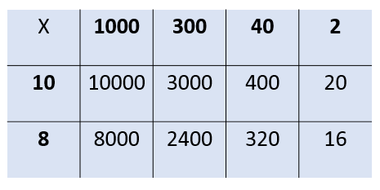
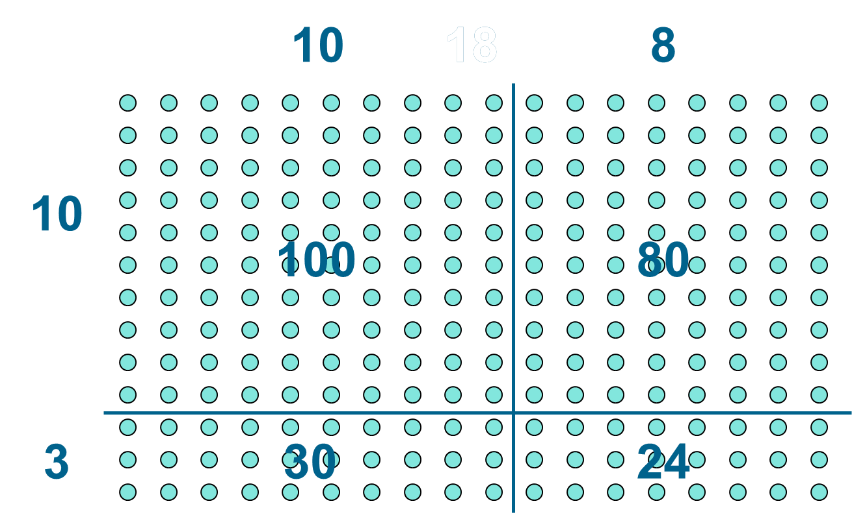
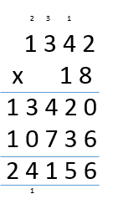
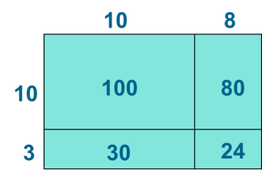
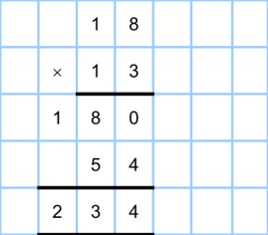
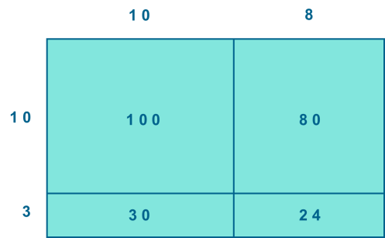
Year 4 | Year 5 | Year 6
Continue with a range of equations as in Year 2 but with appropriate numbers. Also include equations with missing digits 2 x 5 = 160 Mental methods Counting in multiples of 6, 7, 9, 25 and 1000, and steps of 1/100. Solving practical problems where children need to scale up. Relate to known number facts. (e.g. how tall would a 25cm sunflower be if it grew 6 times taller?) Written methods (progressing to 3d x 2d) Children to embed and deepen their understanding of the grid method to multiply up 2d x 2d. Ensure this is still linked back to their understanding of arrays and place value counters. | Continue with a range of equations as in Year 2 but with appropriate numbers. Also include equations with missing digits Mental methods X by 10, 100, 1000 using moving digits ITP Use practical resources and jottings to explore equivalent statements (e.g. 4 x 35 = 2 x 2 x 35) Recall of prime numbers up 19 and identify prime numbers up to 100 (with reasoning) Solving practical problems where children need to scale up. Relate to known number facts. Identify factor pairs for numbers Written methods (progressing to 4d x 2d) Long multiplication using place value counters Children to explore how the grid method supports an understanding of long multiplication (for 2d x 2d) | Continue with a range of equations as in Year 2 but with appropriate numbers. Also include equations with missing digits Mental methods Identifying common factors and multiples of given numbers Solving practical problems where children need to scale up. Relate to known number facts. Written methods Continue to refine and deepen understanding of written methods including fluency for using long multiplication
Obj
Gui
Vid
Ex
Obj
Gui
Vid
Ex
Obj
Gui
Vid
Ex

Slide 3
The National Curriculum in England. ©Crown Copyright 2013 Year 4 objectives
Return

Slide 4
The National Curriculum in England. ©Crown Copyright 2013 Year 4 guidance
Return

Slide 5
The National Curriculum in England. ©Crown Copyright 2013 Year 5 objectives
Return

Slide 6
The National Curriculum in England. ©Crown Copyright 2013 Year 5 guidance
Return

Slide 7
The National Curriculum in England. ©Crown Copyright 2013 Year 6 objectives
Return

Slide 8
The National Curriculum in England. ©Crown Copyright 2013 Year 6 guidance
Return

